Slide 1
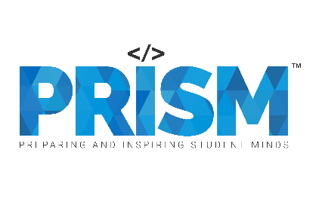
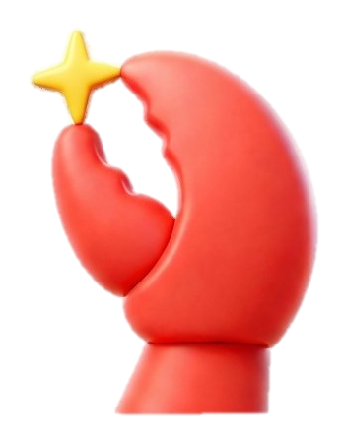
| Tech Management, SRI-B
CLAWS
CLASH OF THE
RV COLLEGE OF ENGINEERING
Collab Mesh
Your entire team, Orchestrated by intelligence
-Priyanshi chouhan &
Sai Prakash J

Slide 2
Idea
Problem Statement
We chose the Productivity theme to solve a common collaboration problem: team context is scattered across chats, docs, and meetings, which slows down decisions and reduces productivity. Our solution is for student teams, startup teams, and small project groups that need a private, shared AI teammate to keep tasks, decisions, and updates in sync.

Slide 3
Idea
Current Solution & Gaps
Existing solutions
Current AI productivity tools like Asana AI Teammates, Microsoft Teams AI, Google Workspace AI, and Slack AI help with task tracking, summaries, and automation.
What’s missing
Most of them still work like single-user assistants. They do not provide a shared project memory, cross-channel coordination, or a persistent AI teammate that understands the whole team’s context over time.
Our opportunity
There is a strong opportunity to build a team-first AI layer that keeps decisions, tasks, and updates in sync across channels, reduces coordination overhead, and helps teams move faster without losing context.

Slide 4
Idea
Your Solutions
What we built
We built Collab Mesh, a shared AI teammate for small teams that helps manage conversations, decisions, and tasks across multiple channels. It acts as a project brain that keeps context, updates, and ownership in one place.
Core idea
Instead of using AI as a single-user assistant, Collab Mesh is designed as a team-level collaborator. It listens to team activity, stores important project memory, and helps the whole group stay aligned without repeated explanations or unnecessary meetings.
Key features
Shared team memory to remember decisions, tasks, and project context.
Discord-based collaboration so teammates can share updates, and coordinate in one shared space.
Task routing and ownership tracking to assign work to the right person.
Async decision support to help teams decide without long calls.
Heartbeat/standup automation to keep the team updated proactively.

Slide 5
Idea
Demo/Product Walkthrough
Screen/Flow
Team channel
alice: decision: ship Friday
TestBot9839: Logged decision #1 — alice ← visible
↓
Team channel
alice: task: build back end design.
TestBot9839: Routed task #1 to @Alex
↓
Direct message (Alex's inbox)
TestBot9839: Synapse — new task ← private
from @alice: ...
How the user Interacts
Action | What user types | Where
Log a decision | decision: <text> | Any team channel the bot is in
Assign a task | task: <text> | Any team channel the bot is in
Overview of tasks and decisions | — | fully automatic.
Key moments
Permanent project memory
The agent picks the right person for the task
Overview of the tasks and decisions by itself.

Slide 6
Idea
Tech & Architecture
Framework: OpenClaw 2026.5.6 — self-hosted multi-channel agent gateway
Runtime: Node.js 24 LTS
LLM: Google Gemini 2.5 Flash (via Google AI Studio)
Chat surface: Discord — via OpenClaw's bundled @openclaw/discord plugin
Data layer: plain Markdown + JSON files (no database)
Scheduling: OpenClaw's built-in cron primitive
Deploy: PowerShell script
VCS: Git + GitHub
OS tested: Windows 11 (works on macOS/Linux unchanged)
APIs Used:
Google Gemini 2.5 Flash
WORKFLOW:
Discord → OpenClaw (Discord plugin) → Gateway → Pi agent → reads SKILL.md
↓
calls memory + message tools
↓
updates .md files / posts to Discord

Slide 7
Idea
Impact & Use cases
Real-life scenarios
Student project teams: One member asks the AI to summarize decisions, assign follow-up tasks, and keep the team aligned after class.
Startup teams: A small founding team uses it to track product decisions, action items, and ownership without long meetings.
Hackathon teams: Team members share updates in Discord, and the AI keeps one project memory so nothing is lost.
Distributed teams: When people work at different times, the AI acts like a shared teammate that remembers context and maintains continuity.
Scale potential
Collab Mesh can start with small student and project teams, then expand to larger groups, clubs, incubators, and even enterprise teams that need shared context and faster coordination. The same core idea can scale across different collaboration environments because it is built around persistent memory, task routing, and team-wide alignment.

Slide 8
Idea
Differentiation
In business, a moat is a sustainable competitive advantage that protects a company from competitors and helps maintain long-term profitability MOATS : 1. Shared project memory moat: The more the team uses Collab Mesh, the richer its project memory becomes. That creates a compounding advantage because the system understands decisions, patterns, and team behavior better over time, making it harder to replace.
2. Workflow lock-in moat: Collab Mesh becomes the place where decisions, tasks, and updates live. Once a team relies on it for alignment and execution, switching to another tool becomes costly because the project history and context are already embedded in the system

Slide 9
Idea
Demo Link
GitHub Repo: https://github.com/sgpfhgg/Synapse
Demo Link: https://www.youtube.com/watch?v=ZD-X9JaGYrc.

